Slide 1
flex-direction
flex-wrap
flex-flow
justify-content
align-items
align-content

Slide 2
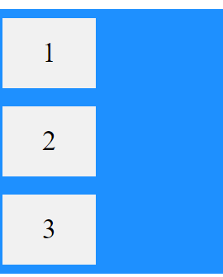
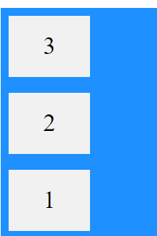


flex-direction
Column
Column-reverse
Row
Row-reverse

Slide 3
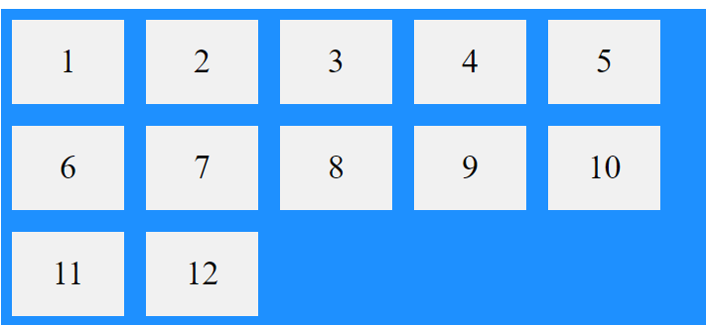
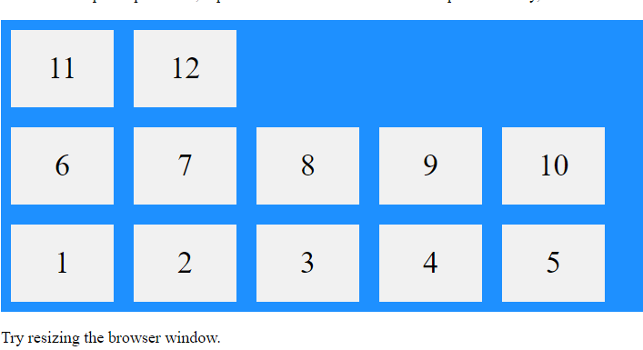

flex-wrap
Wrap
Nowrap
Wrap-reverse

Slide 4

flex-flow
Flex-direction and flex-wrap

Slide 5





justify-content
Center
Flex-start
Flex-end
Space-around
Space-between

Slide 6
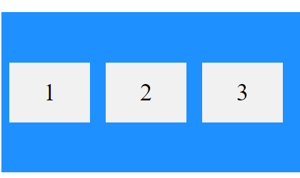
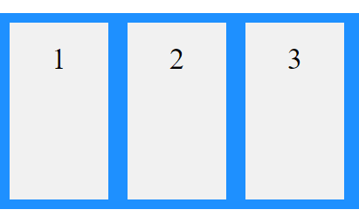
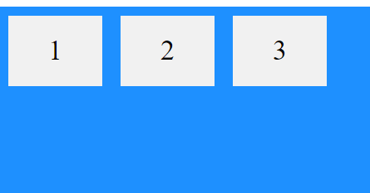
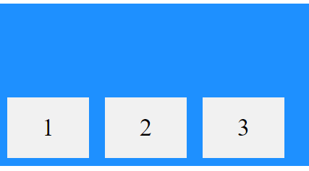
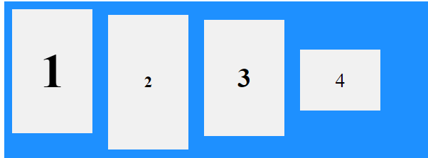
align-items
Center
Flex-start
Flex-end
Stretch
baseline

Slide 7

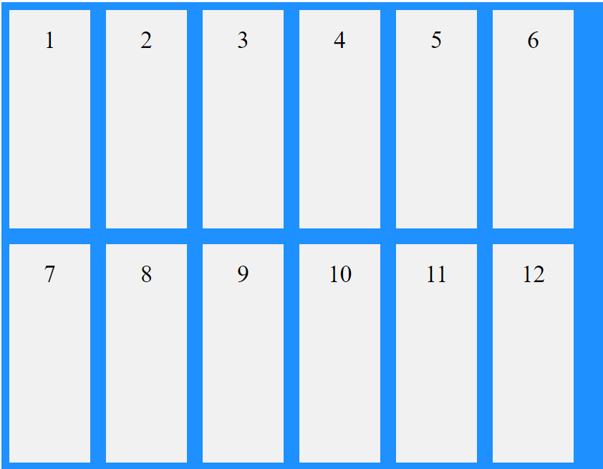
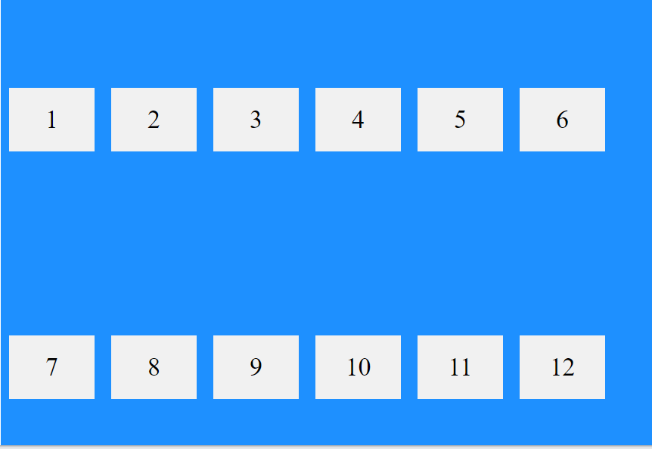
align-content
Space-between
Space-around
stretch

Slide 8
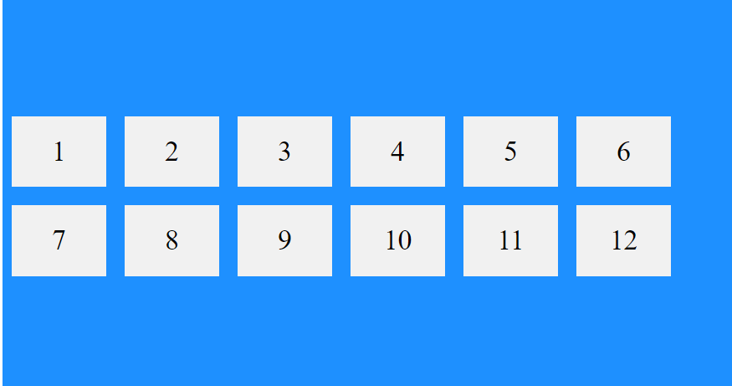
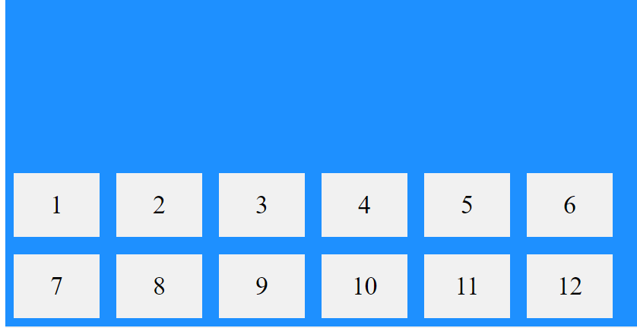
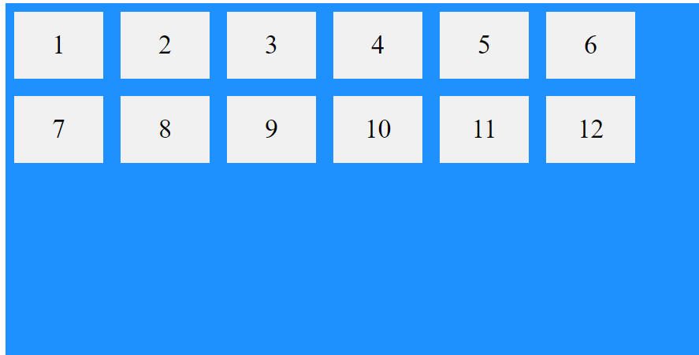
align-content
Center
Flex-start
Flex-end

